Slide 1

Cyber Threat Analysis
Nirbhay Singh Naruka, Viswadatta Chinta, Prit Shah, Pranav Upadhyaya

Slide 2

Main Objectives
Most attacked countries
Threat on countries based on internet users and GDP
Insider threat identification
Sectors most affected by cyber attacks
Notes:
We used cloudwatch to trigger AWS Lambda to start sagemaker instance by leveraging lifecycle configuration we are executing python while automatically using a tool papermill.
Our main objectives were these 4 analysis.

Slide 3



Types of Threats
OWASP - 60.4%
Automated-31.3%
DDoS - 8.3%
Notes:
- Our findings have highlighted three primary threats, with the majority of these being classified under OWASP-related incidents, which represent 60.45% of the total threats identified.
- The next substantial category is Automated Threats, which accounted for 31.26% of the recorded incidents. Within this category, Ransomware was the predominant type of attack.
- Lastly, DDoS, or Distributed Denial of Service attacks, accounted for 8.29% of the total threats. While this is the smallest percentage of the three, DDoS attacks remain a critical concern due to their ability to disrupt service availability, which can have severe impacts on business operations and services.

Slide 4
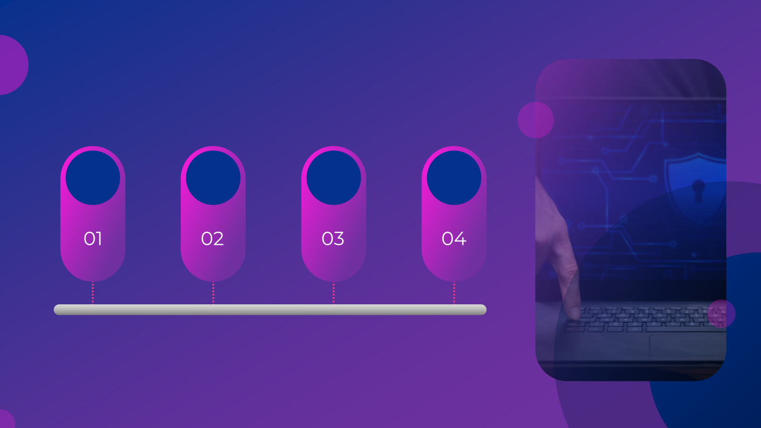




Analysis Workflow
Imperva API
Sagemaker
Selenium Chrome drivers
S3
Notes:
we are using imperva api, then aws sagemaker for the analysis, seleium chromedrives to access and download the data, and s3 for storing the files and insights

Slide 5
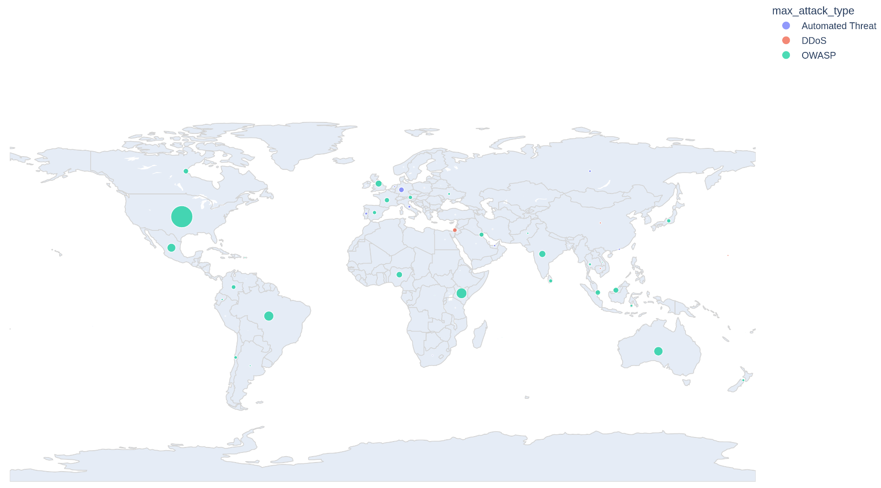

Most attacked countries in the past week
Notes:
Our main data source was Imperva An american cyber security software and services
Our main focus was narrowing the attacks down to who are being targeted the most under which type of attacks.
As we can see from this map they are a lot more OWASP attacks than any other type of attacks.
OWASP attacks are most critical web application security risks.
Organizations and developers prioritize these types of attacks mostly to increase their cyber security.

Slide 6


How GDP & internet users affects cyber threat
Explored what might affect the cyber threat
attacks.
GDP of the country
Number of internet users
We considered the number of internet users to be important as they are the gateway for cyber attacks.

Slide 7
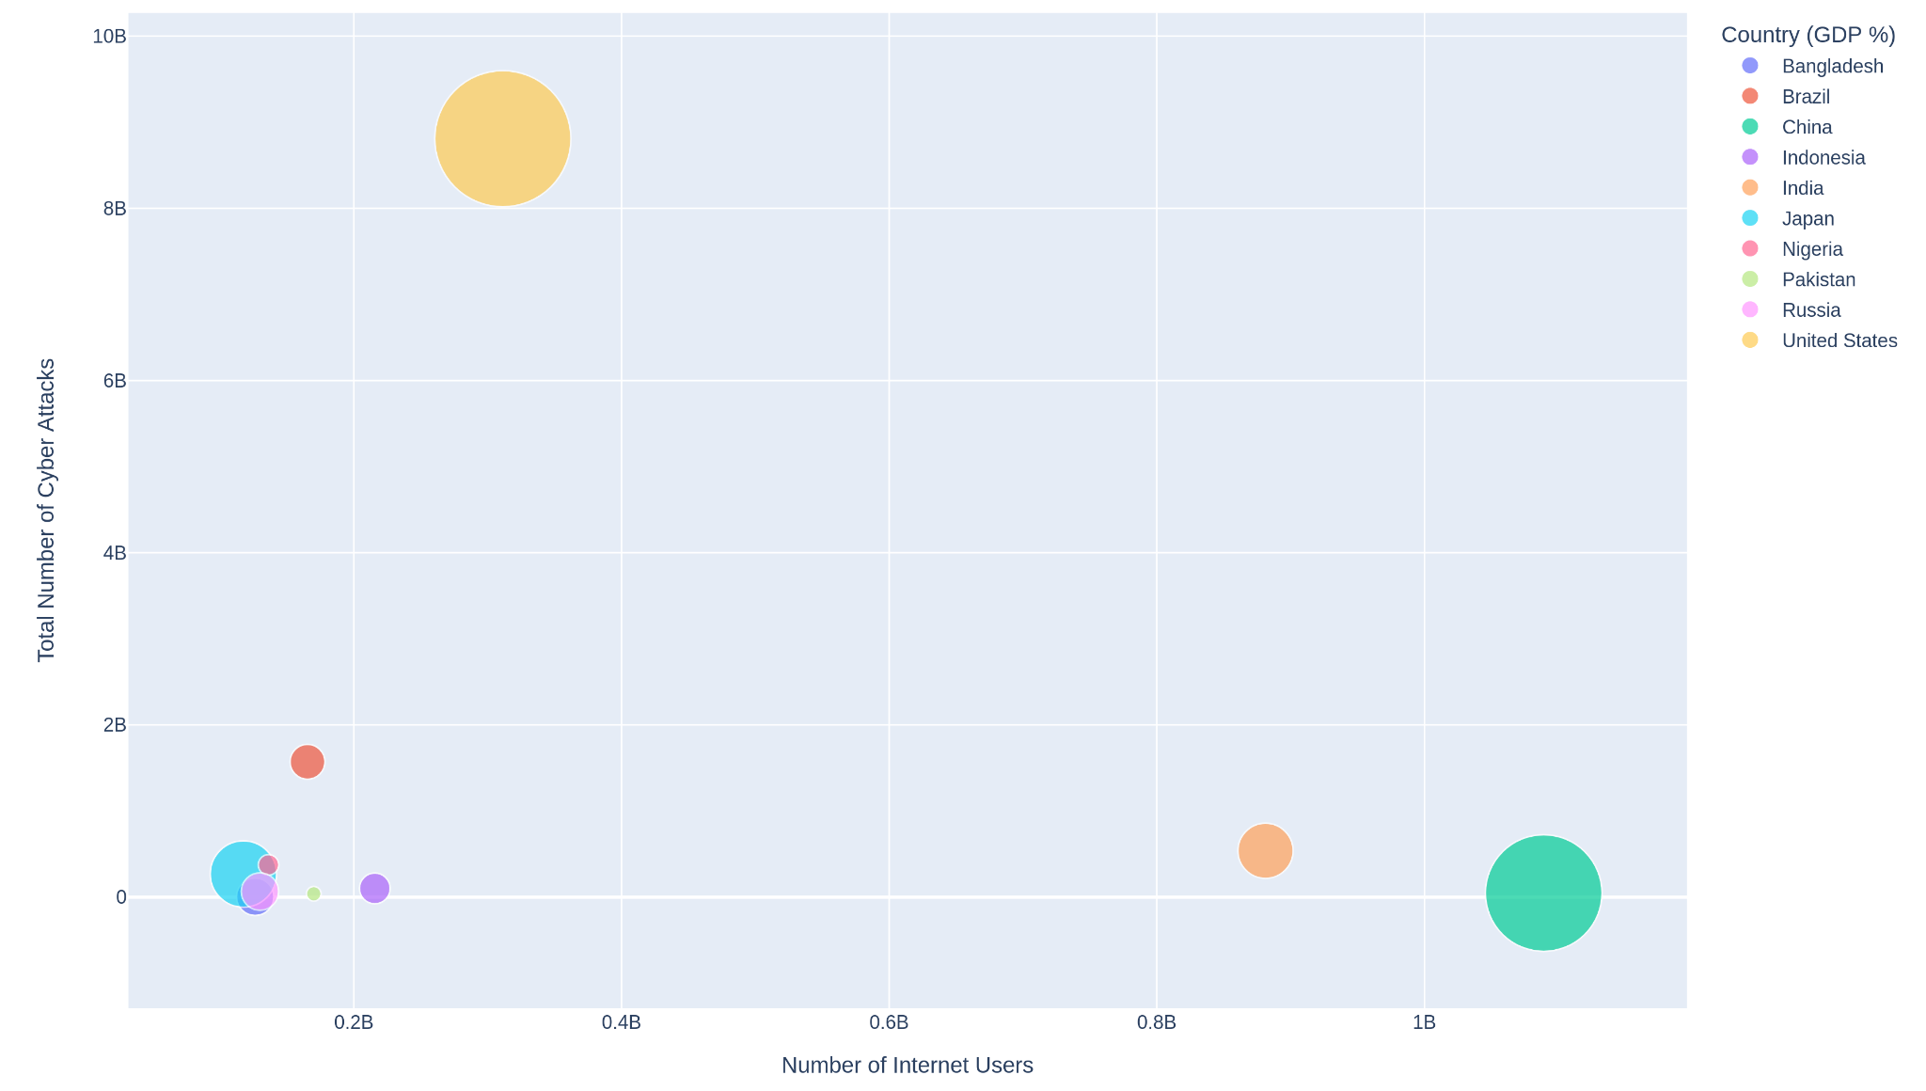
Threats based on Internet users and GDP of countries
Notes:
We then wanted to know how does the number of attacks vary between higher GDP countries by also taking the number of people who have access to internet.
This graph gave us an idea that higher GDP countries with larger percentage of people having access to internet are more vulnerable to cyber attacks.
although China has a larger population with internet access, their regulations on internet access to outside world might have played a better role in reducing cyber attacks as compared to USA.

Slide 8

Origin of attacks
Origin of these different type of attacks
main priority of all type of attacks
found new intent behind attacks
Notes:
On further in depth analysis on highly targeted countries, the origin and target of attacks. We found their main priority to be their own country for most of the highly targeted ones.

Slide 9
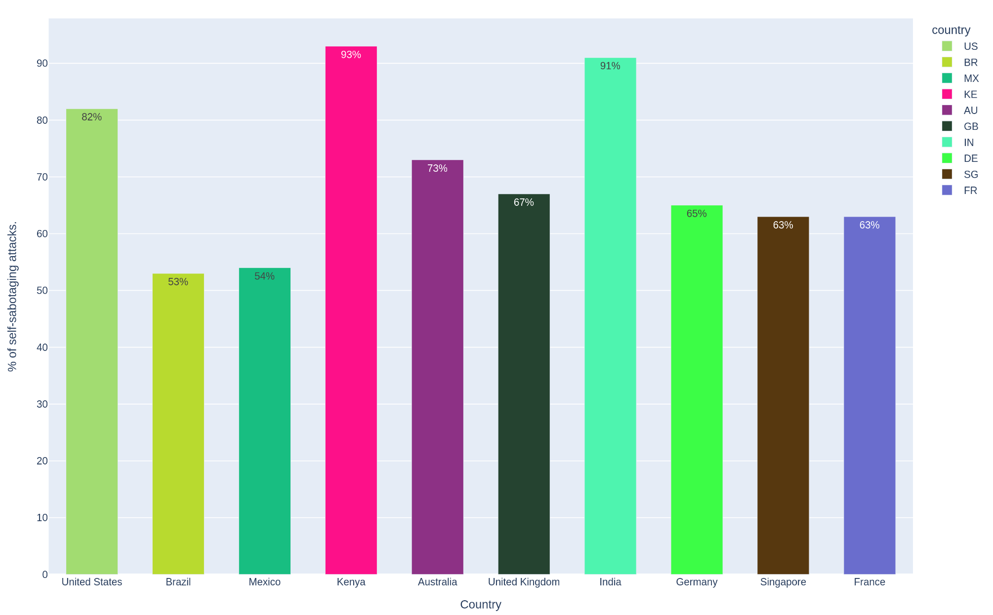
Insider threat Identification
Notes:
This graph shows the countries sorted by most number of attacks and the percentage of attacks done on themselves. We categorized them to be insider threat identification for security purposes among companies where the companies analyze data to find potential insider threats by looking for users who access data not typically within their role or who perform actions at unusual times.

Slide 10
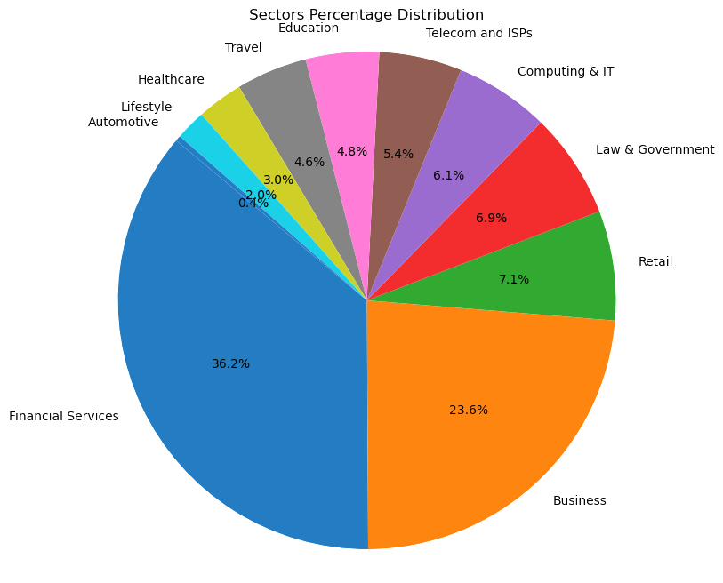
Sectors most affected
Notes:
As we mention about the sectors in Version 1 about the sector and Health care being top 3 but
The sectors of Financial Services, Business, and Retail are the most prominent on the chart, indicating that they have the largest shares of ich could be the number of cyber threats received,
Financial Services being at the top with the largest slice, followed by Business and then Retail, suggests that they have the highest percentages within this distribution. There are several reasons why these sectors could appear prominently:
Volume of Transactions: Financial Services and Retail typically handle a high volume of transactions, which can lead to higher exposure to threats or incidents.
Value of Transactions: The financial sector, in particular, deals with large monetary transactions, which can make it a more attractive target for cyber threats.
Data Sensitivity: Both Financial Services and Business sectors handle sensitive data that can be valuable for cybercriminals, increasing the number of attacks.
Regarding cyber security prioritization, it's not necessarily the case that the Financial Services sector is less likely to prioritize it.
However, due to the lucrative nature and high volume of transactions, it is often targeted more frequently by cybercriminals, despite robust security measures.
That could explain why it appears prominently in terms of receiving threats. The visibility and size of the sector can also lead to a higher number of recorded incidents simply due to the sector's scale.

Slide 11

Conclusion
Global Presence of Cyber Threats
Urgency of Prioritizing Cybersecurity
Importance of Personal Data Protection
Notes:
Our research reveals the widespread presence of cyber threats worldwide and stresses the crucial need to prioritize cybersecurity. By showing how these threats affect personal data, we hope to stress the importance of protecting it. Our goal is to encourage everyone to be more aware and take steps to stay safe online.
Cyber threats are a big deal in our world where everything is connected. They can put our personal and work data at risk. It’s really important to know how common these threats are and to take steps to keep our data safe. If we all learn about cyber safety and use good security habits, we can make our online world safer for everyone.

Slide 12
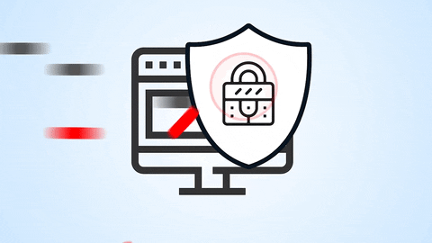
Thank You!

